Slide 1
Predictive Modeling and Data Mining
Week 1- Introduction
Mohammad Esmalifalak
September 2020

Slide 2
Work load and Evaluation
A mix between theory and lab work
10 Marked labs
Lab Assignments 50% Labs (See deadlines)
Report + presentation 50% (See deadlines)

Slide 3
Course Objective
The course will introduce predictive modelling techniques as well as related statistical and visualization tools for data mining.
The course will cover common machine learning techniques that are focused on predictive outcomes.
Students will learn how to evaluate the performance of the prediction models and how to improve them through time.

Slide 4
What’s Data: Definitions
Data
Information
Knowledge
Wisdom
A continues or discrete measured feature
which by itself, doesn’t have much value

Slide 5
Data Modeling
Data Modeling
Descriptive Models
Predictive Models
Assoc Rules
Clustering
Summarization
classification
Time series
Regression
Predictors

Slide 6

Data Modeling
Supervised Learning
Un-supervised Learning
300K
200K
100K
Price ($)
1000 1500 2000
Size of house ${ft}^{2}$
Market Segmentation (Clustering)
We know the TRUE output and
algorithm learns from that.
We don’t know the TRUE output
(number of clusters, clustering rules, etc. )

Slide 7
Data Modeling
Regression
Clustering
Flower A
Flower B
300K
200K
100K
Sepal Width
Price ($)
Sepal length
1000 1500 2000
Size of house ${ft}^{2}$
Output label is continues
Output label is discrete (2 or more classes)

Slide 8

Predictive Modeling in Python
Data Cleaning with Pandas
Array Operation with Numpy
Predictive Aglorithms with Sklearn

Slide 9
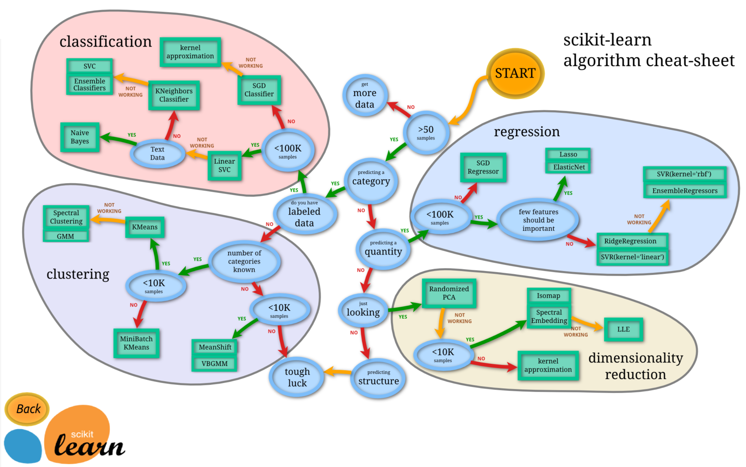
Scikit-Learn Cheat sheet
Ref:
https://scikit-learn.org/stable/tutorial/machine_learning_map/index.html

Slide 10
Course Schedule

Slide 11
In this course:
We will go through various predictive methods and algorithms.
Programming language will be python.
Python review: https://www.w3schools.com/python/python_reference.asp

